Slide 1
RANKED CHOICE VOTING

Slide 2
OVERVIEW
01.
Introduction
03.
The RCV Ballot
05.
Benefits of RCV
07.
RCV Results
02.
What is RCV?
04.
Why RCV?
06.
RCV Tabulation
08.
Questions

Slide 3
INTRODUCTION
Gretchen Reinemeyer
Director of Elections
Tate Fall
Deputy Director
Tania Griffin
Communications & Outreach Coordinator

Slide 4
WHAT IS RANKED CHOICE VOTING
(RCV)?
A voting method in which voters rank candidates in order of preference (1st choice, 2nd choice, 3rd choice).

Slide 5
RCV
Allows your vote to count towards another candidate if your 1st choice candidate is eliminated.
For example, if your 1st choice candidate is eliminated, your vote is transferred to your 2nd choice candidate.
If your 2nd choice candidate is eliminated, your vote is transferred to your 3rd choice candidate.

Slide 6
RCV IN ARLINGTON
Voting process will be very similar to voting on a traditional ballot.
1 sheet ballot Double-Sided
County Board ONLY race using RCV Voters will place ballot into scanner to be counted

Slide 7
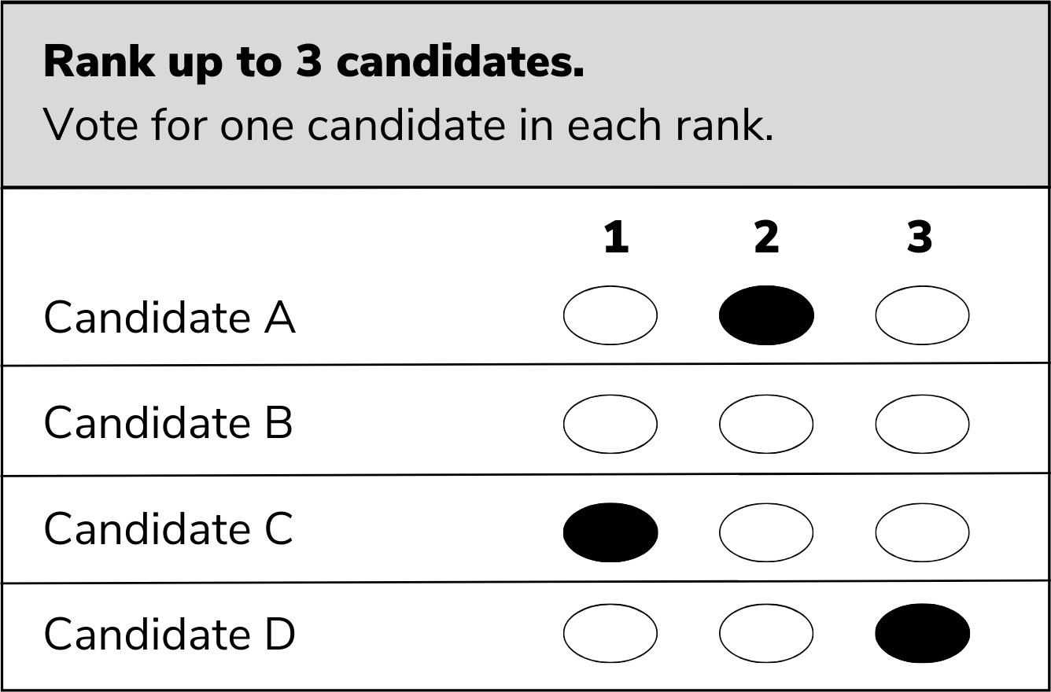
RCV IN ARLINGTON

Slide 8
RCV IN ARLINGTON
You may rank up to 3 candidates
Top 2 candidates will win

Slide 9
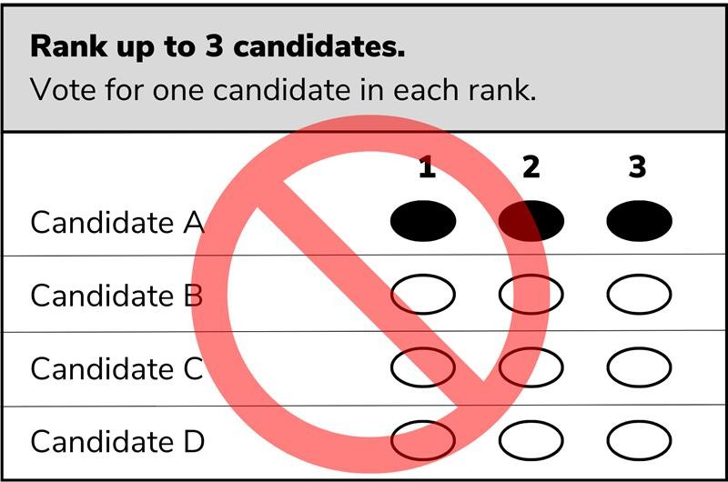
RCV IN ARLINGTON

Slide 10
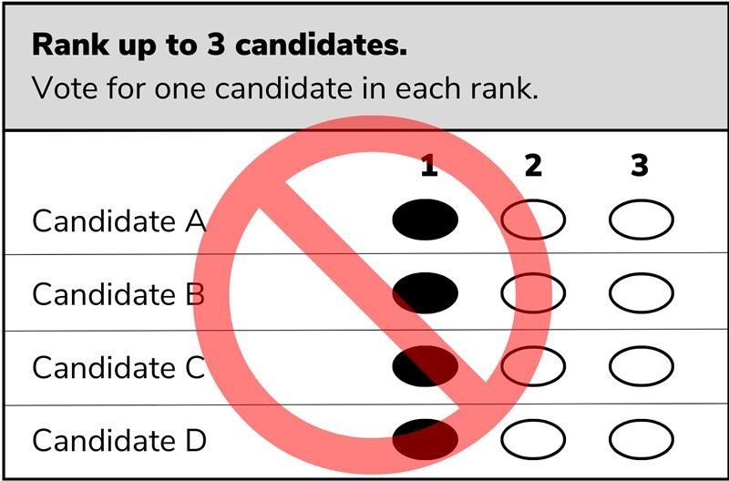
RCV IN ARLINGTON

Slide 11
Let's
Review!

Slide 12
Rank up to 3 candidates. Mark no more than 1 oval in each column.
1 2 3 Candidate A
Candidate B
Candidate C
Candidate D

Slide 13
2nd and 3rd choices are bumped up to 1st and 2nd
Rank up to 3 candidates. Mark no more than 1 oval in each column.
1 2 3 Candidate A
Candidate B
Candidate C
Candidate D

Slide 14
Rank up to 3 candidates. Mark no more than 1 oval in each column.
1 2 3 Candidate A
Candidate B
Candidate C
Candidate D

Slide 15
Ballot becomes inactive if 1st choice is eliminated
Rank up to 3 candidates. Mark no more than 1 oval in each column.
1 2 3 Candidate A
Candidate B
Candidate C
Candidate D

Slide 16
Rank up to 3 candidates. Mark no more than 1 oval in each column.
1 2 3 Candidate A
Candidate B
Candidate C
Candidate D

Slide 17
Candidate B will only get 1 ranking and ballot will become inactive if Candidate B is eliminated
Rank up to 3 candidates. Mark no more than 1 oval in each column.
1 2 3 Candidate A
Candidate B
Candidate C
Candidate D

Slide 18
Rank up to 3 candidates. Mark no more than 1 oval in each column.
1 2 3 Candidate A
Candidate B
Candidate C
Candidate D

Slide 19
Ballot will be rejected
Rank up to 3 candidates.
Mark no more than 1 oval in each column.
1 2
3
Candidate A
Candidate B Candidate C Candidate D

Slide 20
Why is RCV Happening?
In 2020 HB1103 passed by the General Assembly, authorizing localities to use RCV in local, city, and county elections.
Arlington County Board adopted the use of RCV for the June 20, 2023 County Board Democratic primary election in December 2022.

Slide 21
RCV Benefits
Ranking multiple candidates allows voters to still have a choice in who gets elected even if their top choice does not win.
Candidates have to appeal to people who might initially vote for someone else.
Ensures candidates with the broadest support win the election.

Slide 22
How is RCV
tabulated?

Slide 23
Election Threshold
The number of seats in a race determines the threshold of votes needed to win.
Number of Seats
2 Seats
Office
County Board
Votes Needed
33⅓% + 1

Slide 24
Election Threshold
Formula used to establish election threshold:*
Number of ballots cast for office _{+ 1 = Threshold} Number of seats to be filled + 1
* In accordance with 1VAC20-100-10

Slide 25
Counting Votes
Once establishing the election threshold, all 1st choice votes are counted.
If no candidate reaches the threshold of votes needed to win, the candidate with the least amount of votes is eliminated.
Votes from the eliminated candidate are then transferred to the next-ranked candidate on those ballots.
Votes are then re-tallied.

Slide 26
RCV Tabulation
Tabulation process is repeated until:
The required number of candidates to be elected reach the threshold to win.
OR
The number of remaining candidates equals the number of candidates to be elected, and they win.

Slide 27
RCV Results
RCV results will not be known on Election Day.
Confirming winners may take up to 7 days.
Results can only be determined after all ballots cast have been received:
Mail Ballots Provisional Ballots

Slide 28
Subscribe to our newsletter!
vote.arlington.gov/ranked-choice-voting

Slide 29
Questions?

Slide 30
Contact us!
703-228-3456
vote.arlingtonva.gov
voters@arlingtonva.us

Slide 31
Surplus Fractions
If a candidate exceeds the election threshold, a fraction of their votes are transferred to the next- ranked candidates on their ballots.*
Candidate's total # of votes - Threshold _{= Surplus}
Candidate's total # of votes
Fraction
* In accordance with 1VAC20-100-10

